Slide 1
A study of the Fermi bubbles near the Galactic plane
Dmitry Malyshev,
Laura Herold

Slide 2
General information about the project
People involved: Dima, Laura (?)
Category of paper: II

Slide 3
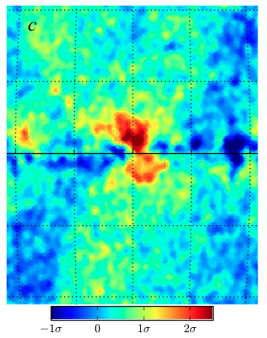
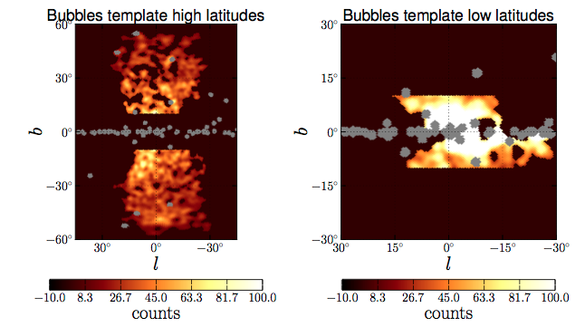
Main goals
Previous results: Left-right asymmetry of the Fermi bubbles at low latitudes?
Acero et al: Model of Galactic interstellar emission (?)
Ackermann et al: Galactic center GeV excess (?)

Slide 4
This analysis
Data selection:
Pass 8 Source class (relatively small area)
8 years (August 4, 2008, - August 3, 2016)
Energies between 300 MeV – 1 TeV in 24 logarithmic energy bins
HEALPix pixelation order 7 (resolution 0.5°)
Analysis strategy:
Very simple model using low-energy Fermi data → not many assumptions necessary
Comparison with GALPROP model

Slide 5
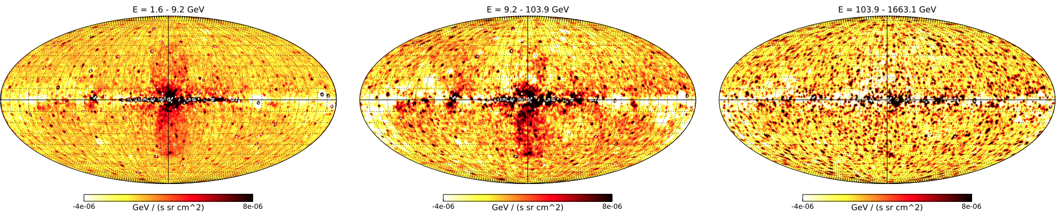
The low-energy model
Components:
Low-energy Fermi data (600 Mev – 1.6 GeV) as a spatial template for foreground (softer spectrum than bubbles): N_{low}
Constant value: c
Normalization of N_{low} and c are fitted to higher-energy data in 4 deg latitude stripes
Region of bubbles is excluded (-20 < l < 20 deg)
Point sources are masked

Slide 6
The boxes model
Components:
As before: N_{low}, c
Rectangles of constant value covering the Fermi bubbles: b
Normalization of N_{low} and c and b are fitted to higher-energy data in 4 deg latitude stripes
Point sources are masked

Slide 7
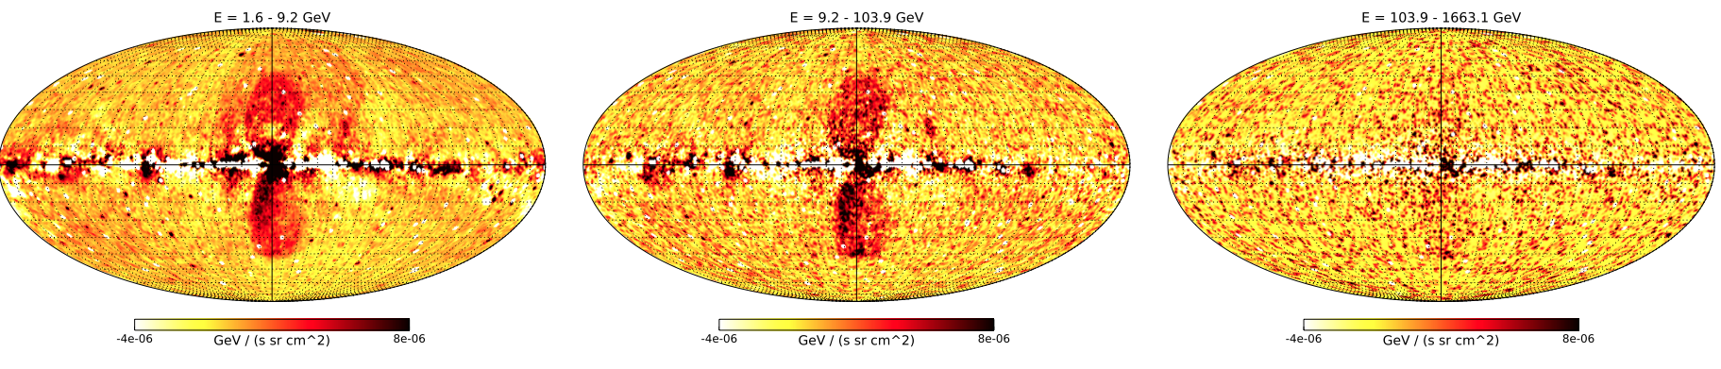
The GALPROP
Components:

Slide 8
Latitude profiles
Longitude profiles east and west of GC (-10 < l < 10 deg)
Left-right asymmetry
Models agree well (on southern hemisphere)

Slide 9
Spectra
→ Left-right asymmetry

Slide 10
Spectra

Slide 11
Spectra

Slide 12
Timeline
End of September: Finish analysis (physics interpretation: fit IC and π⁰ spectra, particle lifetimes, total energy output in terms of SNe)
October: Present more results
End of October: Finish draft

